Slide 2
Modified Hodges

Slide 3
Cutoff 1.5 Hz

Slide 10
First 5 parameter combinations are for different window sizes from 100ms to 300ms step size of 50ms with same weigh of 1

Slide 12
First five combination for the cut-off frequency 1.5 Hz with increasing weights for threshold
The figure here shows the reason of why the separation increases with decreasing window size (or increasing cut-off frequency). With decrease in w size and fixed threshold, signal is less smooth, more false negative, prob detection decreases. But for Null hypothesis, the decrease is relatively higher since there is no muscle activity present (Pd = TP + FN ; assuming active throughout move)

Slide 14
TVD (35) : 5.0000 7.5
KL (40) : 5.0000 8.5000
medIQR(10) : 5.0000 2.5000

Slide 15
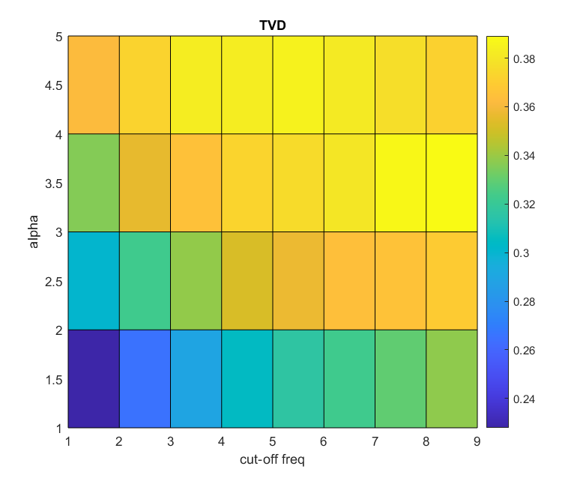
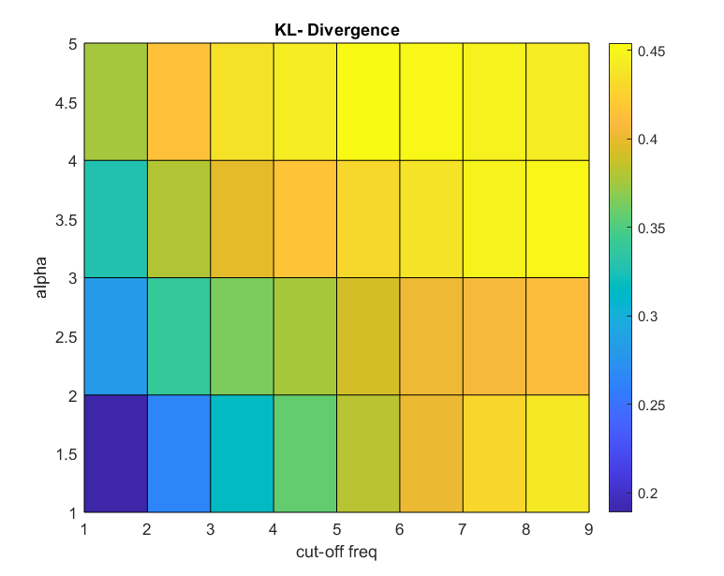

Slide 18
Patient 1

Slide 26
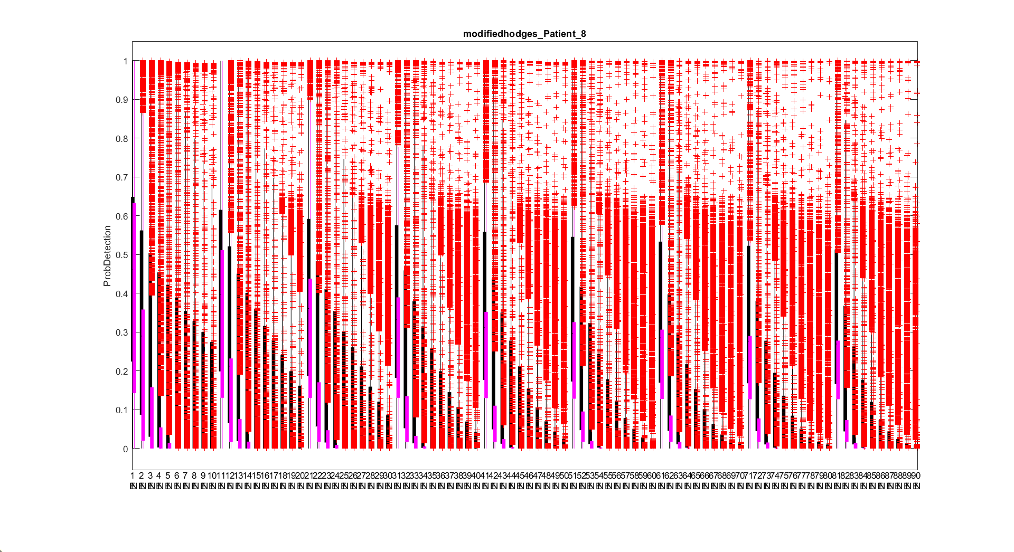

Slide 29
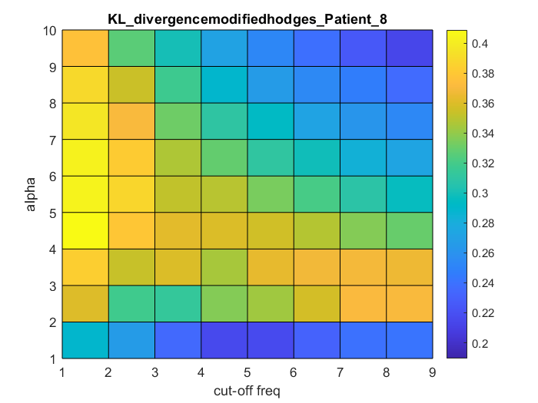
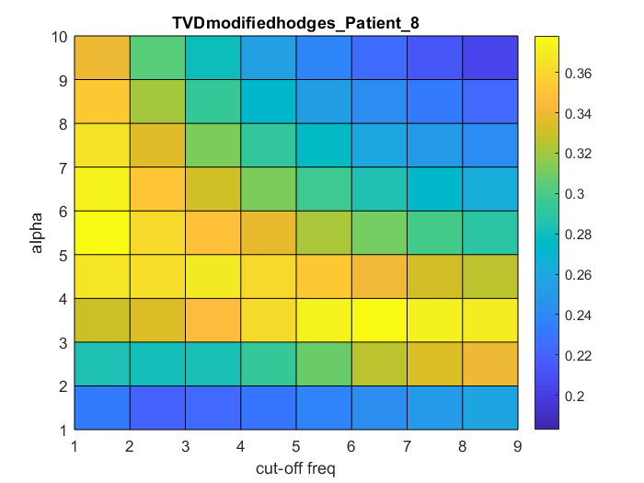
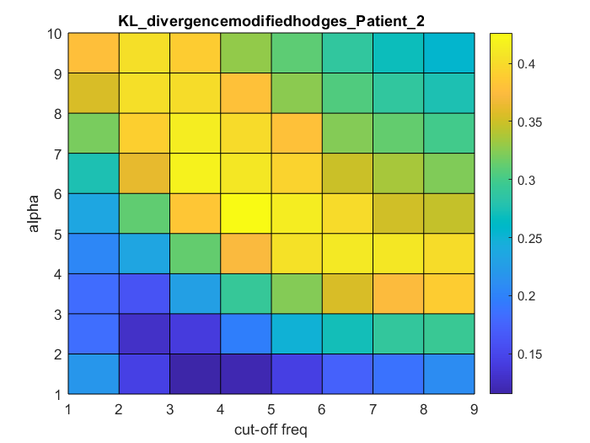
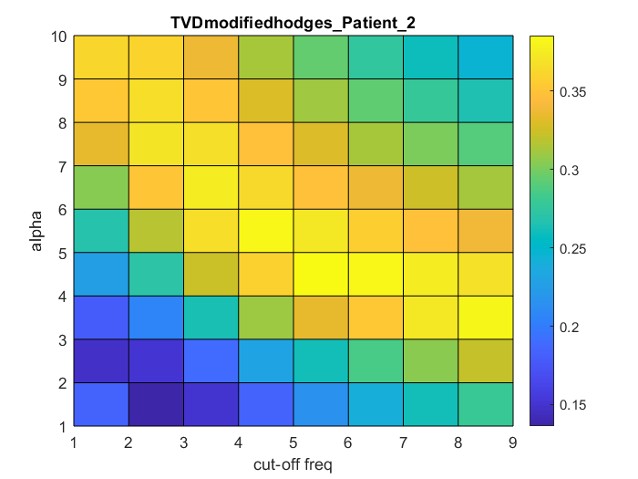

Slide 30
6.0000 1.5000
6.0000 3.5000

Slide 34
Justification for choosing range of weights for modified hodges
Figure shows the histogram of mean subtracted normalized test function (low pass filtered with 100 Hz cut-off frequency) Red curve is the test function of rest phase and blue curve is the test function of move phase. (Trial 1 of patient 1)
So its sufficient to test the weights [2 3].
The reason why we tested for weights [1 10], for lower cut-off frequency maximum separation was increasing so wanted to see for higher weights.
Lpf with cut-off of 100 Hz
Lpf with cut-off of 1.5 Hz
Histogram of raw data

